Slide 1
Marta Hoffman
Research Data Management (RDM)
− what do you need to know about it and what support can you expect
Warsaw, 2024-06-20

Slide 2
Agenda:
What are research data?
What are the requirements about data from research publishers and funders?
Can a Data Management Plan (DMP) be useful?
What help can you expect from the IBB RDM Support?
Feedback from you: what forms of support for RDM would you consider useful?

Slide 3
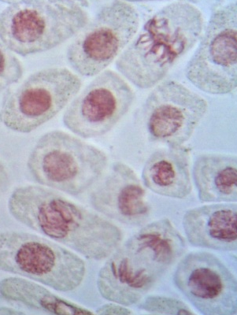
Definition of research data
„Public sector information fixed in electronic form, other than scientific publications, which has been produced or collected as part of scientific activities (…) and is used as evidence in the research process or is used to verify the accuracy of research findings and results.”
(Act on open data and reuse of public sector information - USTAWA z dnia 11 sierpnia 2021 r. o otwartych danych i ponownym wykorzystywaniu informacji sektora publicznego)
≠
KTH Biblioteket, CC-BY-SA https://www.flickr.com/photos/kthbiblioteket/4472640423/
Publications
Research data
Notes:
EC: „Research data is the information (facts or numbers) collected to be examined and considered, and to serve as a basis for reasoning, discussion or calculation.”
US OSTP: „Research data is the recorded factual material commonly accepted in the scientific community as necessary to validate research findings.”
USTAWA z dnia 11 sierpnia 2021 r. o otwartych danych i ponownym wykorzystywaniu informacji sektora publicznego
dane badawcze – informacje sektora publicznego utrwalone w postaci elektronicznej, inne niż publikacje naukowe, które zostały wytworzone lub zgromadzone w ramach działalności naukowej i są wykorzystywane jako dowody w procesie badawczym lub służą do weryfikacji poprawności ustaleń i wyników badań.
„Dane badawcze, będące w posiadaniu podmiotów, o których mowa w art.(…), podlegają bezpłatnie ponownemu wykorzystywaniu, jeżeli zostały wytworzone lub zgromadzone w ramach działalności naukowej finansowanej ze środków publicznych oraz są już publicznie udostępniane w systemie teleinformatycznym podmiotu zobowiązanego, w szczególności w repozytorium instytucjonalnym lub tematycznym.”

Slide 4
Examples of research data
Numerical data
Photographs, films
Mathematical and computer models
Algorithms, scripts, code
Simulation results
Methodologies and workflows
Text documents, lab notes
Questionnaires, responses
• raw, primary
• secondary
• quantitative
• qualitative
• observational
• experimental
• simulational

Slide 5
Data sharing requirements
From funders (grant agreements): require making a Data Management Plan (DMP) and preservation and/or sharing of research data.
From journals (publishing agreements): require sharing of data underlying published article.
Notes:
Funder requirements: the NCN policy follows the guidelines of the organization Science Europe, so it is aligned with most other policies in Europe.

Slide 6
NCN research data policy
You must prepare a Data Management Plan (DMP) for your project and you must report on its implementation.
You are obliged to safely store all scientifically valuable data obtained in the project for at least 10 years and all of the metadata infinitely.
You must openly share all data underlying published findings according to FAIR rules, unless the data should not be opened.
If there are some parts of this data that you are not sharing openly, you must explain why.
Notes:
In Poland, on the governmental level:
2021 NCN: W umowach grantowych zawieranych po 1 stycznia 2021 r.3 dane będące podstawą publikacji naukowych stanowiących efekt realizacji projektów finansowanych przez NCN powinny być (…) (FAIR Data). Tam gdzie to możliwe, dane te powinny być udostępniane w repozytorium, zgodnie z warunkami licencji Creative Commons Public Domain (licencja CC0).
2021: Ustawa z dnia 11 sierpnia 2021 r. o otwartych danych i ponownym wykorzystywaniu informacji sektora publicznego
2022: Polityka Naukowa Państwa, MEiN
2024: Polityka dotycząca Otwartych Danych Badawczych, MNiSW – prace w toku

Slide 7
Why share data?
Two main goals of the move towards Open Research Data:
-- unlocking the full potential of conducted research by fostering data REUSE
-- improving the quality of the scientific record by enhancing research REPRODUCIBILITY
European Commission:
„Open Science encourages collaboration across academia, industry, public authorities, and citizen groups. When these groups are invited to participate in the research and innovation process, creativity and trust in science increases. This engagement process leads to greater transparency in the research process, greater potential impact of research, more efficient research processes and opportunities for global scientific collaboration.”
https://rea.ec.europa.eu/open-science_en
Notes:
REA = Research Executive Agency of the EC

Slide 8
Two main concepts that govern opening of research data
FAIR data
Findable - independent entity, well-described
Accessible - in a repository or archive, without access restrictions
Interoperable - easy to combine with other datasets (format, structure)
Reusable - technically (documentation) and legally (open licensing)
Wilkinson et al., 2016 [https://www.nature.com/articles/sdata201618]
As open as possible, as closed as necessary
legal restrictions, ethical restrictions, planned commercial use of results, …
European Commission Directorate-General for Research & Innovation, 2016 [Guidelines on FAIR Data Management in Horizon 2020]

Slide 9
Research Data Management (RDM)
Research data management is the handling of data throughout all stages of the research data lifecycle.
Create data
Document
Analyze, process, use
Share
Re-use
Preserve
Good RDM is a prerequisite for reproducibility and reuse.
Research data lifecycle
The DMP is intended to help you plan the whole of research data management (RDM) in the project and in this way to assist you in your research activity.

Slide 10
Five steps to consider in RDM
Identifying your data
Managing data during the project
Strategy for long-term preservation of data
Preparing data for archiving and sharing
Assigning resources and responsibilities
Adapted from: Digital Curation Centre, https://www.dcc.ac.uk/guidance/how-guides

Slide 11
1. Identifying your data
Where does your data come from?
How much data do you generate?
What format(s) are your data in?

Slide 12
2. Managing data during the project
Where do you store your data upon generation?
How is your data backed up?
What additional information is required to understand each data file? (metadata)
How do you structure and name your folders and files?

Slide 13
Metadata standards in life sciences
– examples
MIAME – Minimum information about a microarray experiment
(Nature Genetics, 2001, https://doi.org/10.1038/ng1201-365)
MIQE – Minimum Information for Publication of Quantitative Real-Time PCR Experiments
(Clin Chemistry, 2009, https://doi.org/10.1373/clinchem.2008.112797)
REMBI – Recommended Metadata for Biological Images
(Nature Methods, 2021, https://doi.org/10.1038/s41592-021-01166-8)
Notes:
Minimum Information Standards – usually a checklist.

Slide 14
3. Strategy for long-term preservation of data
What should be kept beyond the end of the project?
For how long should it be stored?
What will be shared openly and what will be restricted?
Where will you archive your material?(repository / archive)
Who should have access and under what conditions? (licensing)
Notes:
If you have personal or sensitive data (data on human subjects, patient data), you need to consider how well anonymized it is and whether you can share it openly or not.
Other reasons not to share openly: planning to commercialize, ethical reasons.

Slide 15
Data repositories
Whenever available:
specialized (specified types of data, usually structured)
e.g. GenBank, PDB, PRIDE, GEO, BioImage Archive…
Otherwise:
generalist (any file formats, any structure of metadata):
disciplinary (e.g. Dryad or BioStudies for biological sciences, Pangaea for Earth sciences) or general (Zenodo)
Notes:
Repository: should assign a persistent identifier (doi or unique accession number); should have a plan for what happens when it goes out of operation; should be well-known in the community.

Slide 16
What is open data?
“Open data is data that anyone can access, use and share.
Governments, businesses and individuals can use open data to bring about social, economic and environmental benefits.”
https://data.europa.eu

Slide 17
What is open data?
“Open data is data that anyone can access, use and share.
Governments, businesses and individuals can use open data to bring about social, economic and environmental benefits.”
open licensing!
https://data.europa.eu

Slide 18
NCN data licensing policy
NCN grant agreements:
„Data underlying scientific publications resulting from a research project should be (...) made available in a repository, where possible, under the terms of the Creative Commons Public Domain license (CC0).”
Notes:
Umowa NCN, par 5: „Dane będące podstawą publikacji naukowych będących efektem realizacji projektu badawczego powinny być (…) udostępniane w repozytorium, tam, gdzie to możliwe, zgodnie z warunkami licencji Creative Commons Public Domain (licencja CC0).”

Slide 19
Public Domain - works not protected by copyright
Public Domain Mark
Public Domain Dedication
Means that the work is not protected by copyright
Use if you want to release your work from copyright and database protection
CC-BY is an open license that allows usage of the work under the conditions of attribution.
[recommended for publications]
Notes:
The public domain: the total of creative works of humanity that is not protected by IPR. CC0 applied automatically: GenBank, PDB, PRIDE…

Slide 20
4. Preparing data for archiving and sharing
Preparing files
Preparing metadata and additional documentation
Submitting data (at time of article acceptance)
Notes:
Some of this could be done during figure preparation.

Slide 21
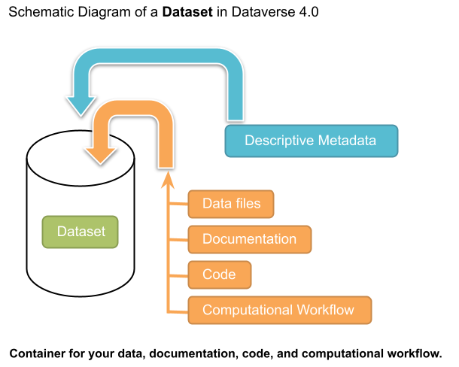
Dataset
https://guides.dataverse.org/en/latest/user/dataset-management.html, © 2024, Harvard College

Slide 22
5. Assigning resources and responsibilities
Who is responsible for data management in the project?
Who will be organizing, documenting and depositing data? Is the time needed for this taken into account?
Are any financial resources needed, e.g. for the provision of additional equipment?

Slide 23
Data management plan
Planning your research, creating a DMP
Conducting research, implementing the DMP
End of project,
report on your DMP
Modifying your DMP

Slide 24
The most common errors in DMPs submitted to NCN
All data are available in the article
Data made available in Supplementary material
Not individualized DMP - scheme duplicated by researchers from the same research organization - the DMP is always evaluated in the context of a given research project!
Data will not be made available - no justification
Adapted from: Natalia Galica, NCN, CC-BY

Slide 25
RDM Support at IBB
1. Individual consultation on:
– preparation of a research data management plan for a grant application,
– selection of data to be shared openly from a research project,
– selection of an appropriate database / repository for the data,
– determining the legal status of the data and deciding on data licensing,
– any further questions you may have concerning research data management and open data.
2. Materials available on the IBB website
(https://ibb.edu.pl/en/research-data-management/)
– Helpsheet for preparing a DMP
– List of suggested repositories

Slide 26
What support would you find useful?
other forms of support?
training? (on what aspects?)
other needs?
Contact me:
rdm@ibb.waw.pl

Slide 27
What support would you find useful?
other forms of support?
training? (on what aspects?)
other needs?
Contact me:
rdm@ibb.waw.pl
Thank you for your attention
Marta Hoffman 2024, presentation licensed CC-BY 4.0, except material marked otherwise

Slide 28
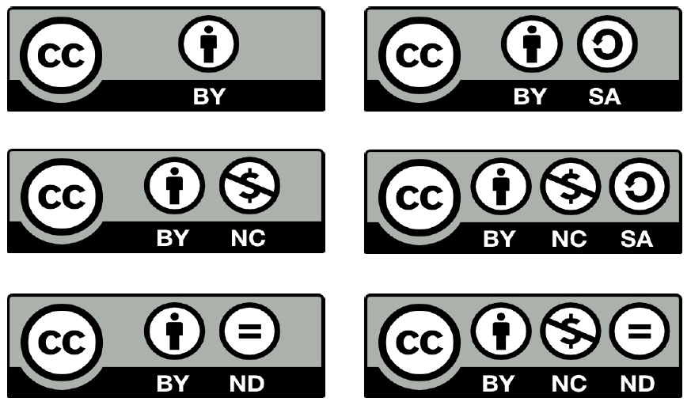
Creative Commons Licenses
BY – Attribution
SA – Share Alike
NC – Non-commercial
ND – No derivatives

Slide 29
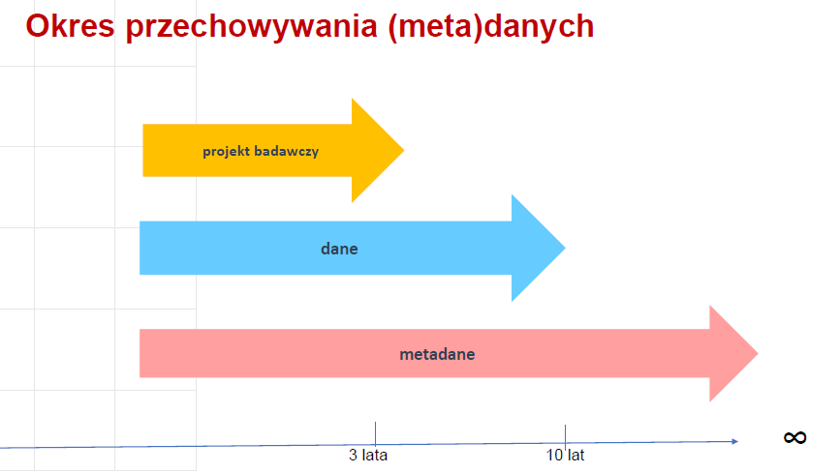
Natalia Galica, NCN, CC-BY

Slide 30
Open Research Data as part of Open Science and governmental initiatives
2002: Budapest Open Access Initiative Declaration;
2004: OECD Declaration on Access to Research Data From Public Funding;
2017: Open Research Data Pilot of the European Commission for H2020 projects;
2019: Directive no 2019/1024 of the EP and of the Council (EU) of 20 June 2019
on open data and the re-use of public sector information;
2021: Act on open data and reuse of public sector information [Ustawa z dnia 11 sierpnia 2021 r. o otwartych danych i ponownym wykorzystywaniu informacji sektora publicznego]
2022: European Strategy for Data, Data Act, Data Governance Act
2022: Polityka Naukowa Państwa, MEiN
2024: Polityka dotycząca Otwartych Danych Badawczych, MNiSW – coming soon

